Slide 1
Badminton journey
Ken Pao
ART 352 - Final

Slide 2
Deliverables
Github Link: https://kpao2020.github.io/art352-final/
Design Concept & Design Choice
User Flow - Miro link
Ideation Sketches
Style Guide - Figma link
Responsive Wireframes - Figma link
High Fidelity Mockups - Figma link
Screen recording – embedded videos
Mobile prototype video link
Desktop prototype video link
List of Improvements and changes

Slide 3
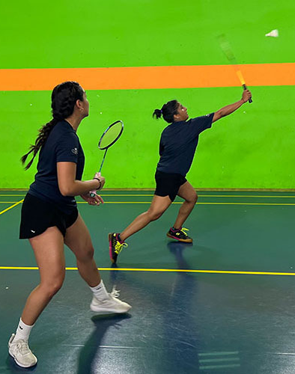
Design concept
Simple, straightforward, easy to read.
Pictures driven.
Badminton court color and Yonex brand color.
Contact form and Social Media on footer.
All external resources links on 1 page.
Reduce Mobile display – less scrolling.

Slide 4

Design choice
Bintang - https://bintangbadminton.org/
Take away: back to top button, green / blue color theme
Yonex - https://www.yonex.com/
Take away: 4 cards for equipment, social media on footer
Eastbay Badminton Association - https://www.eastbaybadminton.com/
Take away: CTA form at bottom, fonts

Slide 5
User flow
External Resources
Home
Learn
Badminton
About

Slide 6
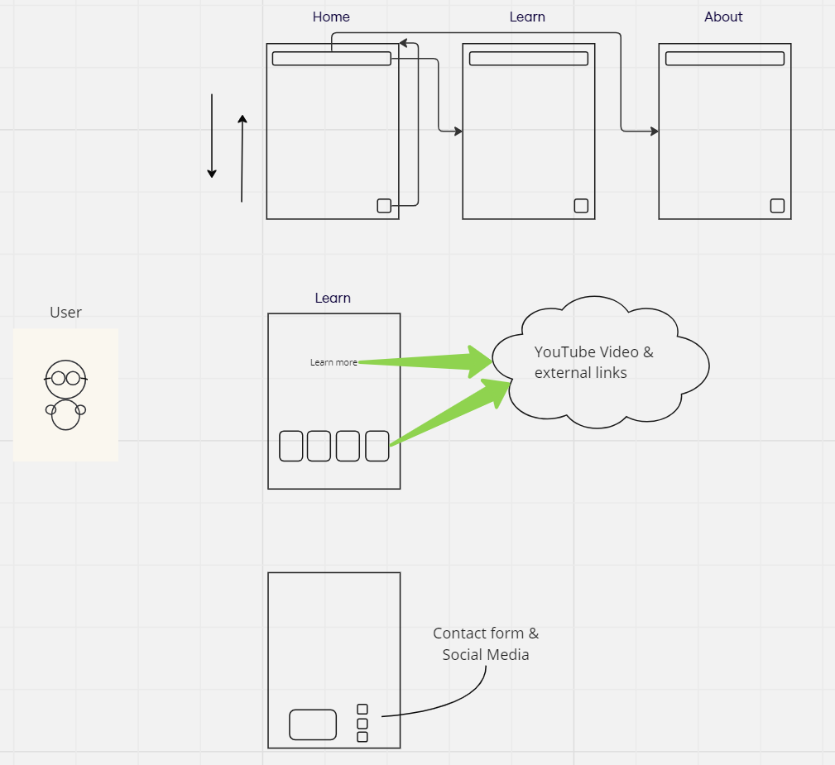
User flow
Home
Navigation
Learn
contact

Slide 7
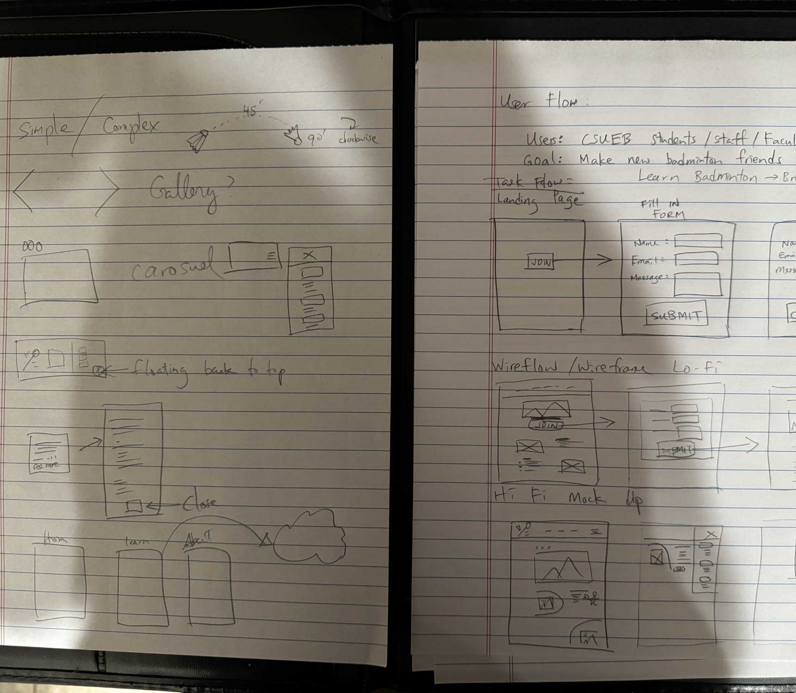
Ideation sketches

Slide 8
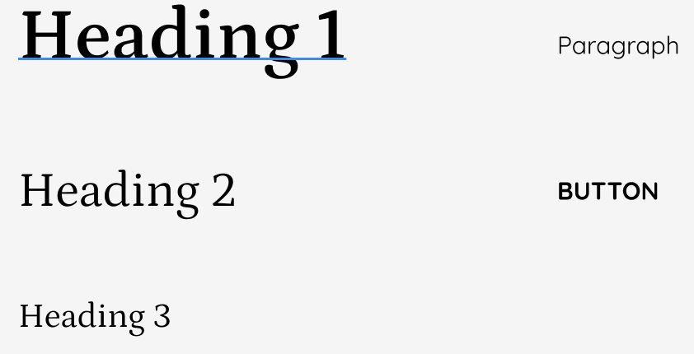
Style Guide
Headings :
Petrona Semi Bold
Paragraph, Button:
Quicksand

Slide 9
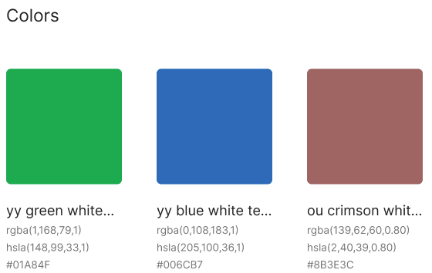
Style Guide

Slide 10
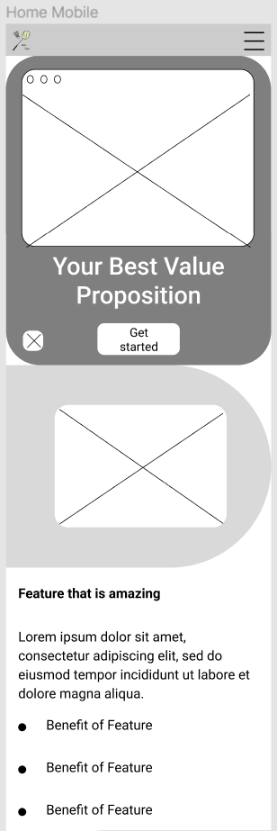
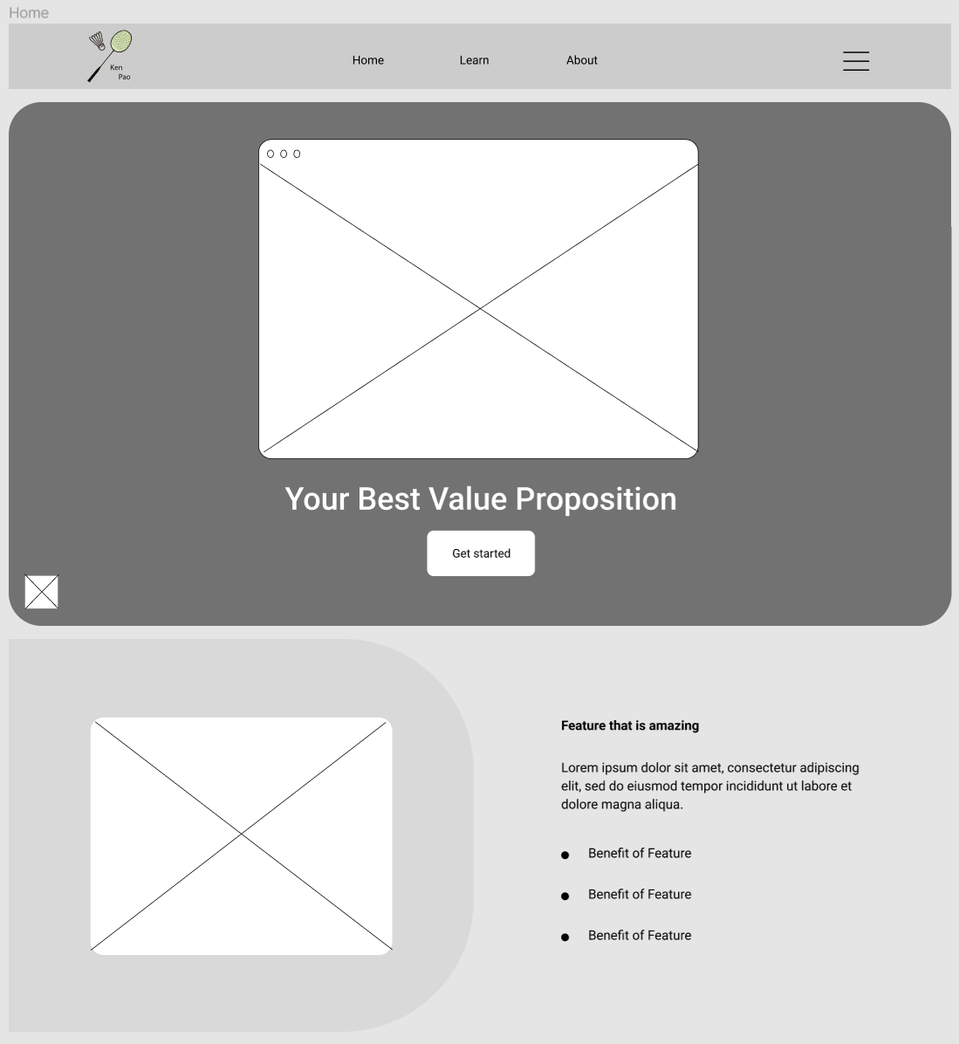
Responsive wireframes

Slide 11
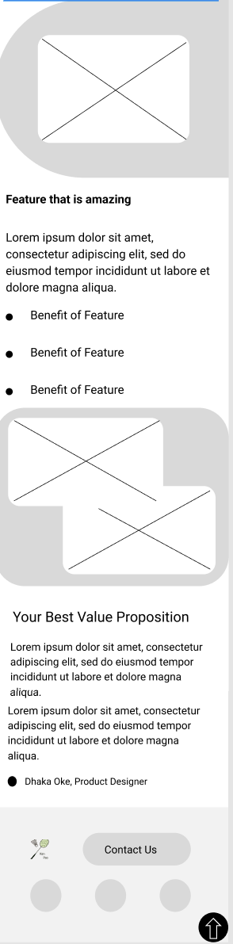
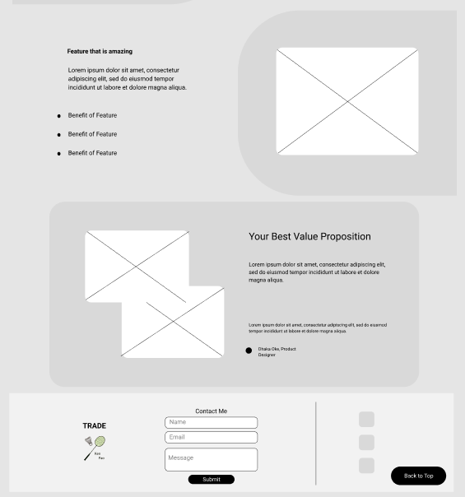
Responsive wireframes Continues

Slide 12
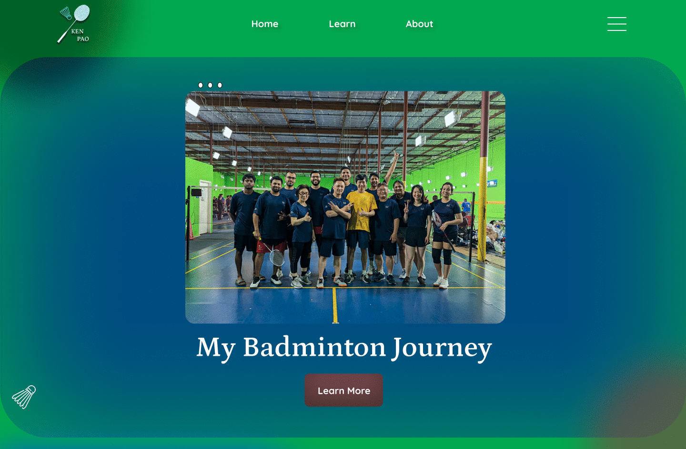
High Fidelity Mockups - Home
Fixed Nav Bar on top
Blended background color
Clickable carousel
Single CTA button
Fun animation

Slide 13
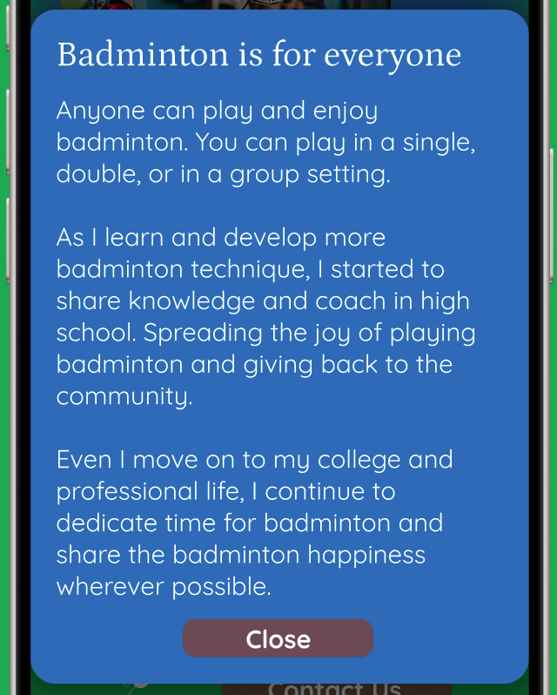
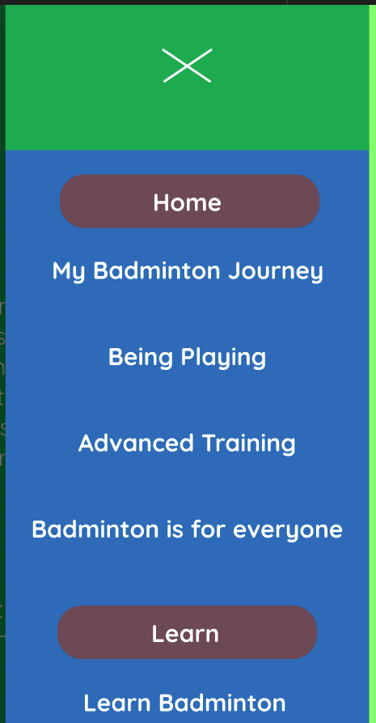
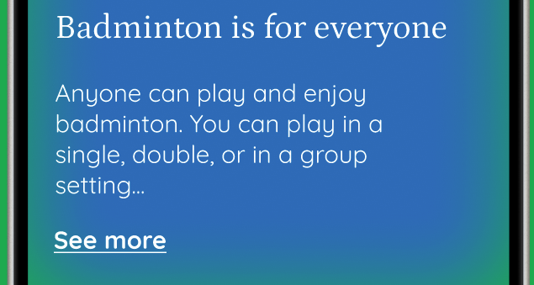
High Fidelity Mockups - features
Hamburger –
Closed overlay
Page and sectional Nav
Text expander on mobile
Reduce scrolling

Slide 14
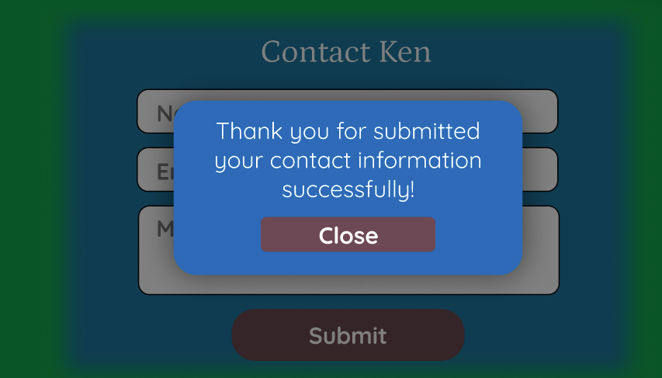
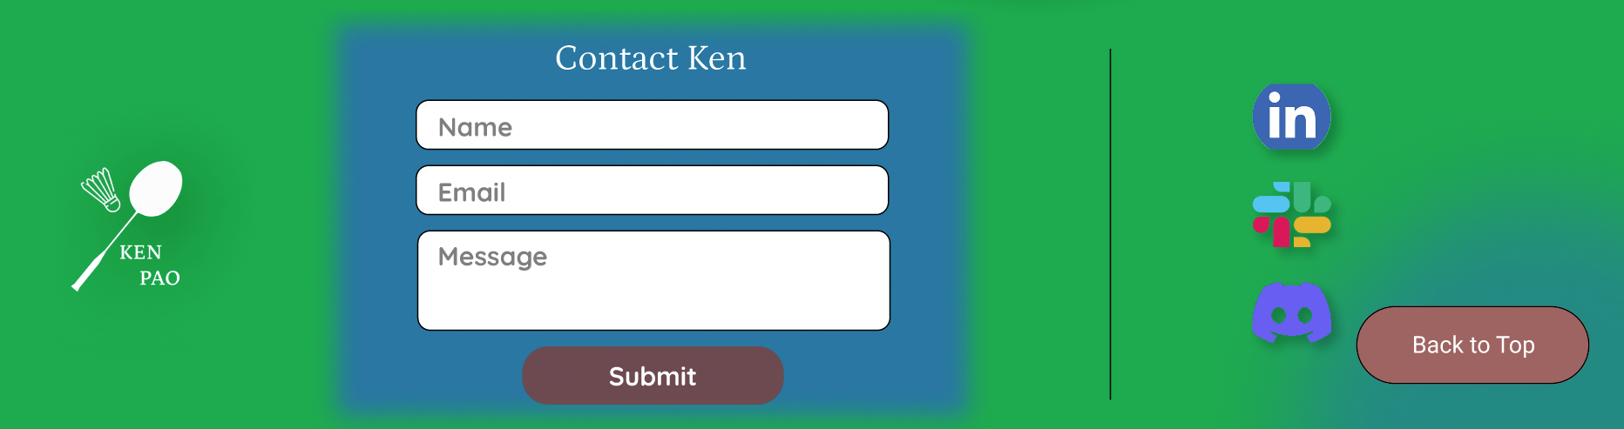
High Fidelity Mockups - features
Contact form and social media on footer
Confirm CTA user feedback
Back to top button
Floating

Slide 15
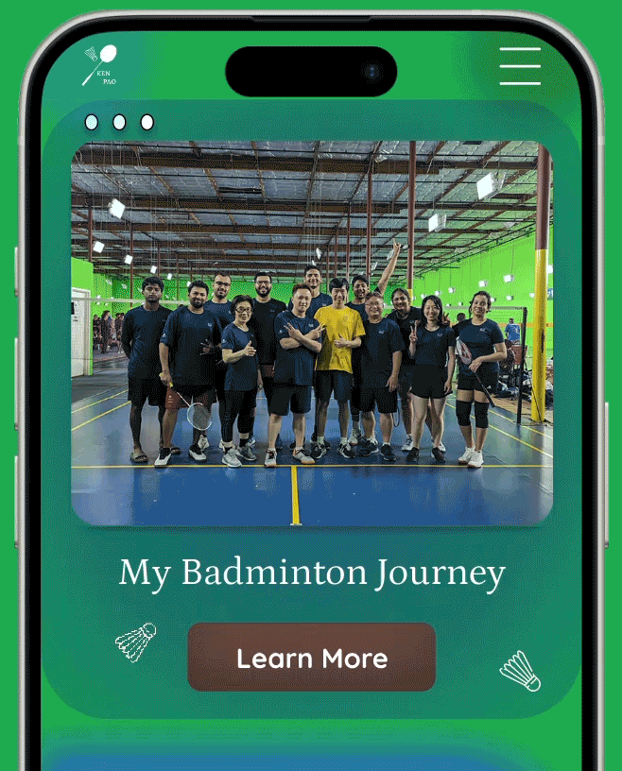
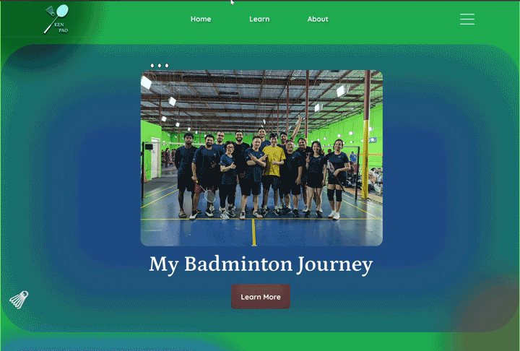
Mobile and desktop demo (~3 min)

Slide 16

Prototype links
Mobile Prototype Link
Desktop Prototype Link

Slide 17
List of improvements and changes :1
Carousel Previous and Next overlay arrow-shaped buttons and auto image scrolling
Change – 3 dots / no Previous / Next buttons / no auto scrolling
Hover state on Navigation Items and Badminton Equipment section => Transform 1.2 (expanding when hovered)
Change – no transformation
Text shadow for all navigation items, headings and card footers
Change – no text shadow
Button shadow for all buttons
Change – no button shadow
Image shadow on logo
Change – no image shadow

Slide 18
List of improvements and changes :2
Box shadow on footer Contact form
Change – sharp border instead of blur and add shadow
Learn Feature gradient background border radius change on mobile view (576px)
Change – was color blue in prototype, but find changing border radius in mobile view is more satisfying
Add a closed button on Mobile Contact form
Change – no close button, use “Contact Ken” as a non-intuitive collapse
Add a “dismiss” toggle to all local anchor to Offcanvas submenu
Change – no “dismiss” toggle. User click on an anchor link, submenu will not “go-away.”

Slide 19
List of improvements and changes :3
Unable to style alert popup message due to system limitation. Using inline text show/hide method as a workaround.
Tested bootstrap popover plugin but unable to get it to work.
1 small bug – when on mobile view clicking the Next button on cards while in hiding layout on both learn and about page, when user changes from mobile view to desktop view, 1 of the card may be hidden. – Discussed with Nikita and ok to leave the bug.
Update animation in style.css:
from using viewport width and viewport height
to left with a percentage and top with a fixed pixel

Slide 20
Thank you https://kpao2020.github.io/art352-final/

